Slide 1
SOCIAL DISTANCING SENSOR

Slide 2
INTRODUCTION
Social distancing plays a pivotal role in preventing the spread of viral diseases Illnesses such as COVID-19. By minimising the close physical contact among people, we can reduce the chances of catching the virus and spreading it across the community. This project to provide a comprehensive survey on how emerging technologies.
We provide a comprehensive background of social distancing including basic concepts, measurements, models, and propose various practical social distancing scenarios. We then discuss enabling wireless technologies which are especially effect- in social distancing, e.g., Detection of people, and Contact tracing.

Slide 3
With the help of this gadget we can maintain a social distance in a crowd. This gadget gives signals whenever we are breaking social distancing rules with the help of beep sound.
The practice of social distancing means staying home and away from others as much as possible to help prevent spread of COVID-19. The practice of social distancing encourages the use of things such as online video and phone communication instead of in-person contact.

Slide 4
ABSTRACT
The ongoing COVID-19 corona virus outbreak has caused a global disaster with its deadly spreading. Due to the absence of effective remedial agents and the shortage of immunizations against the virus, population vulnerability increases. In the current situation, as there are no vaccines available; therefore, social distancing is thought to be an adequate precaution (norm) against the spread of the pandemic virus. The risks of virus spread can be minimized by avoiding physical contact among people.

Slide 5
The purpose of this work is, therefore, to provide a deep learning platform for social distance tracking using an overhead perspective. The framework uses the YOLOv3 object recognition paradigm to identify humans in video sequences. The transfer learning methodology is also implemented to increase the accuracy of the model. In this way, the detection algorithm uses a pre-trained algorithm that is connected to an extra trained layer using an overhead human data set.

Slide 6
LITERATURE SURVEY
The last two decades have seen an explosion in the use of digital technology. It has accelerated human’s exposure to prolonged screen time which is becoming a growing concern. Digital technology is essentially the use of electronic devices to store, generate or process data; facilitates communication and virtual interactions on social media platforms using the internet (Vizcaino et al., 2020). Electronic devices include computer, laptop, palmtop, smartphone, tablet or any other similar devices with a screen. They are a medium of communication, virtual interactions and connectedness between people. Social connection is fundamental to humans.

Slide 7
In addition, social connectedness also enhances mental well-being. COVID-19 pandemic has imposed digital platforms as the only means for people to maintain socioemotional connection (Kanekar and Sharma, 2020). The digital technology is influencing how people use digital devices to maintain, or avoid social relations or how much time to spend for virtual social connectedness (Antonucci et al., 2017).

Slide 8
METHODS
The review was conducted using Arksey and O’Malley’s scoping review framework (Arksey and O’Malley, 2005).
Search Strategy and Selection Criteria
References for this review were identified through searches of
PubMed, Psych INFO, and Google Scholar with the search terms
“screen time,” “social connectedness,” “digital habits,” “health” and “COVID-19” from January 2020 until June 2021.

Slide 9
These keywords were combined with Boolean operators to narrow down the search results. Manual searches were executed to identify additional articles based on the references mentioned in the articles selected for full- text review. Records published in English language were considered for the review. The initial search yielded 1,038 records (PubMed-137; PsychINFO-12; Google Scholar-889) of which 636 were excluded based on title review and duplications.

Slide 10
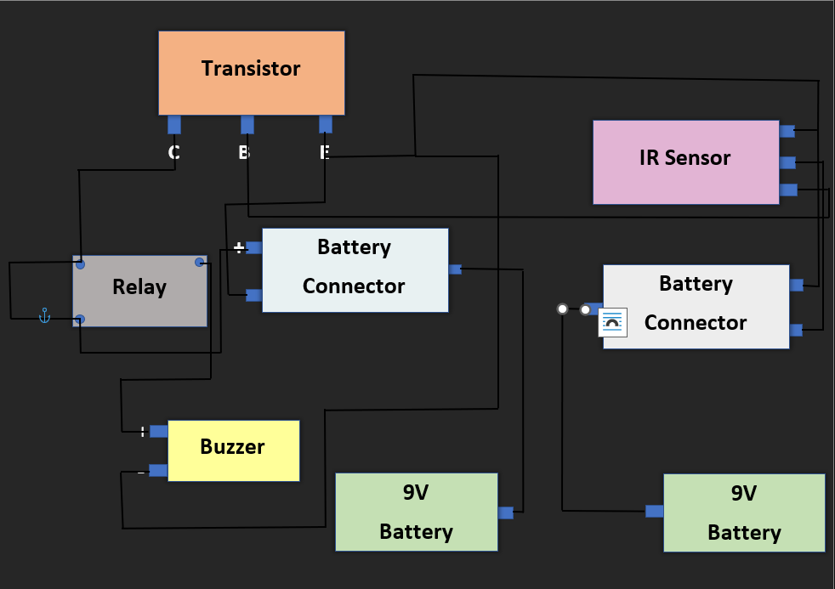
BLOCK DIAGRAM

Slide 11
BUZZER
An audio signalling device like a beeper or buzzer may be electromechanical or piezoelectric or mechanical type. The main function of this is to convert the signal from audio to sound. Generally, it is powered through DC voltage and used in timers, alarm devices, printers, alarms, computers, etc. Based on the various designs, it can generate different sounds like alarm, music, bell & siren.
This buzzer was launched in the year 1831 by an American Scientist namely Joseph Henry but, this was used in doorbells until they were eliminated in 1930 in support of musical bells, which had a smooth tone.

Slide 12
The specifications of the buzzer include the following.
The frequency range is 3,300Hz
Color is black
The frequency range is 3,300Hz
Operating Temperature ranges from – 20° C to +60°C
Operating voltage ranges from 3V to 24V DC
The sound pressure level is 85dBA or 10cm
The supply current is below 15mA

Slide 13
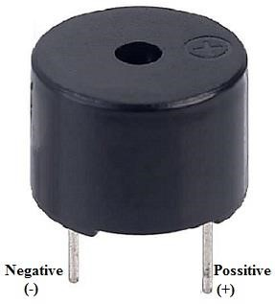
BUZZER

Slide 14
RELAY (5V)
Before we proceed with the circuit to drive the relay we have to consider two important parameter of the relay. Once is the Trigger Voltage, this is the voltage required to turn on the relay that is to change the contact from Common->NC to Common->NO.
Our relay here has 5V trigger voltage, but you can also find relays of values 3V, 6V and even 12V so select one based on the available voltage in your project. The other parameter is your Load Voltage & Current, this is the amount of voltage or current that the NC, NO or Common terminal of the relay could withstand, in our case for DC it is maximum of 30V and 10A. Make sure the load you are using falls into this range.

Slide 15
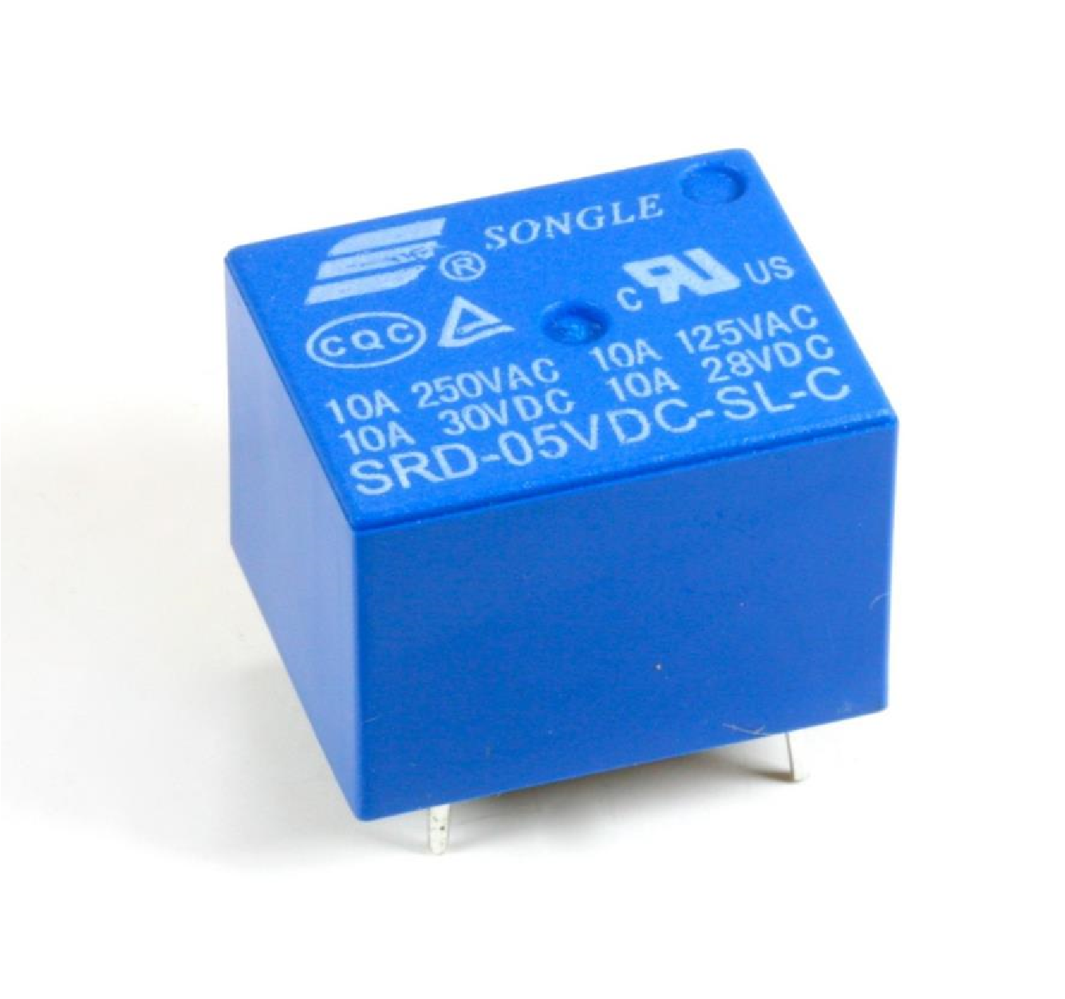
REALY (5V)

Slide 16
TRANSISTER BC547
The BC547 transistor is an NPN transistor. A transistor is nothing but the transfer of resistance which is used for amplifying the current. A small current of the base terminal of this transistor will control the large current of emitter and base terminals. The main function of this transistor is to amplify as well as switching purposes.
The maximum gain current of this transistor is 800A.The similar transistors are like BC548 & BC549. This transistor works in a fixed DC voltage in the preferred region of its characteristics which is called the biasing. Further, the series of this transistor can be divided into three groups based on the current gain like BC547A, BC547B & BC547C

Slide 17
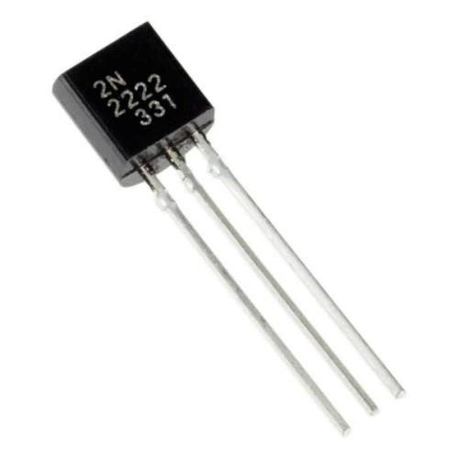
TRANSISTER BC547

Slide 18
IR SENSOR
IR sensor is an electronic device, that emits the light in order to sense some object of the surroundings. An IR sensor can measure the heat of an object as well as detects the motion. Usually, in the infrared spectrum, all the objects radiate some form of thermal radiation. These types of radiations are invisible to our eyes, but infrared sensor can detect these radiations.
The emitter is simply an IR LED (Light Emitting Diode) and the detector is simply an IR photodiode. Photodiode is sensitive to IR light of the same wavelength which is emitted by the IR LED. When IR light falls on the photodiode, the resistances and the output voltages will change in proportion to the magnitude of the IR light received.

Slide 19
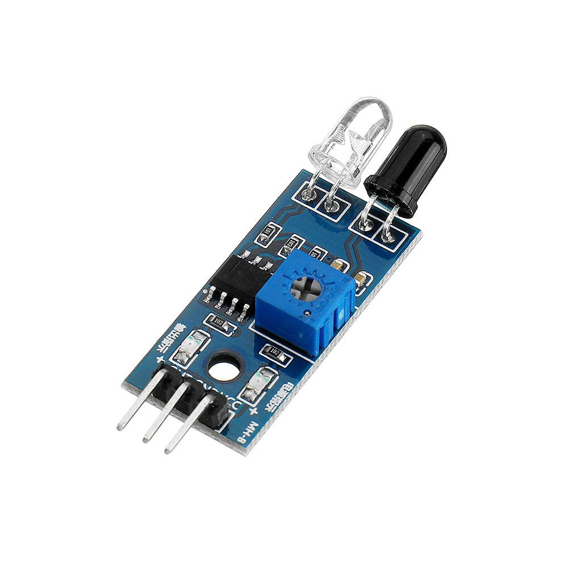
IR SENSOR

Slide 20
BATTERY
The nine-volt battery, is an electric battery that supplies a nominal voltage of 9 Volts, actually 7.2 to 9.6 volts, depending on technology.
When a battery is supplying power, its positive terminal is the cathode and its negative terminal is the anode.[2] The terminal marked negative is the source of electrons that will flow through an external electric circuit to the positive terminal. When a battery is connected to an external electric load, a redox reaction converts high-energy reactants to lower-energy products, and the free-energy difference is delivered to the external circuit as electrical energy. Historically the term "battery" specifically referred to a device composed of multiple cells; however, the usage has evolved to include devices composed of a single cell.

Slide 21

BATTERY

Slide 22
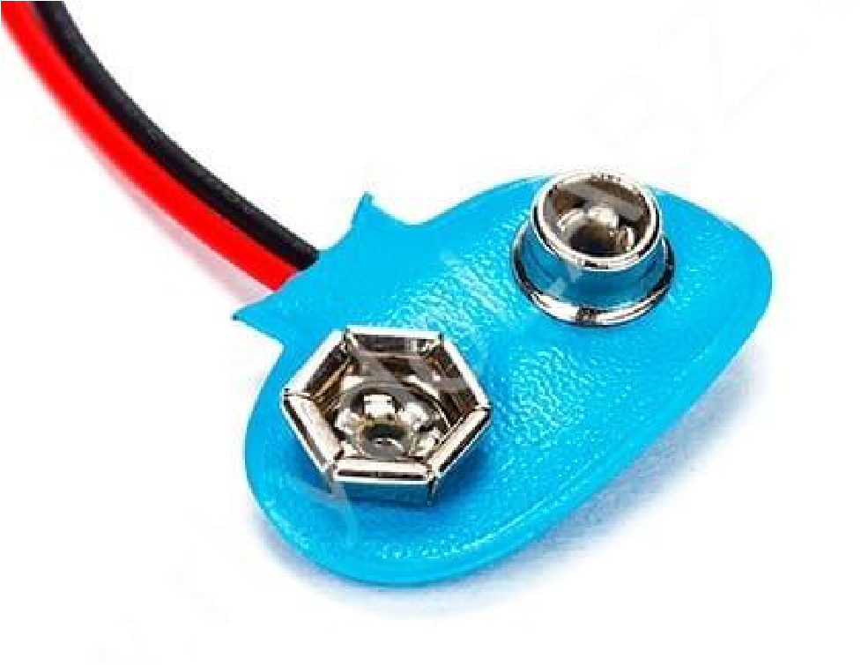
BATTERY CONNECTOR
What is a battery connector. The connector is a device that joins electric circuits together. Most battery packs require more than one connector. The main battery connector is both the mechanical and electrical part that interfaces the battery to the PDA or other electronic device.

Slide 23
SWITCH
A switch is an electrical component that can disconnect or connect the conducting path in an electrical circuit, interrupting the electric current or diverting it from one conductor to another.
The most common type of switch is an electromechanical device consisting of one or more sets of movable electrical contacts connected to external circuits. When a pair of contacts is touching current can pass between them, while when the contacts are separated no current can flow.

Slide 24
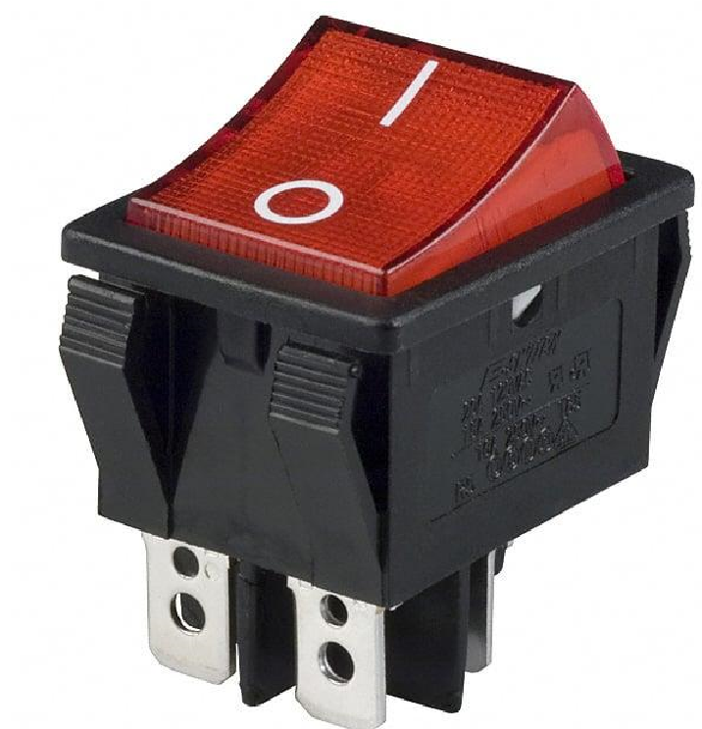
SWITCH

Slide 25
THANK YOU…

